Slide 1

My Healthy fridge
MBD 2019 APR—Group D

Slide 2
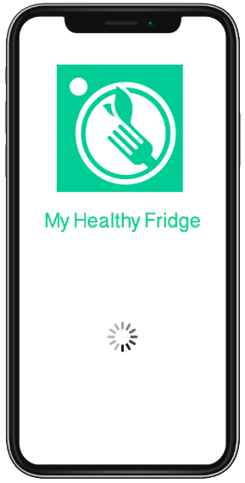
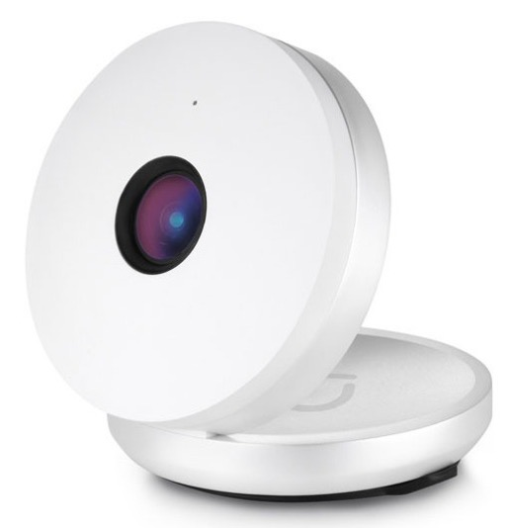
1
Opportunity
2
Products and Services
3
Business Model & Operational Plan

Slide 3



Opportunity
It's time consuming to think about what to cook and to buy
“95% of diets” fail according to the Council of size and Weight Discrimination
People don’t know what they have in the fridge when going to supermarket

Slide 4
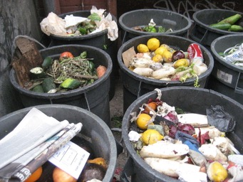
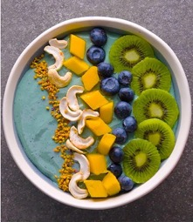
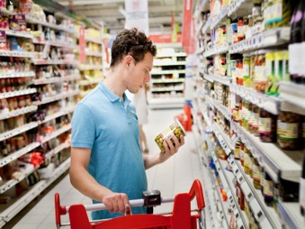
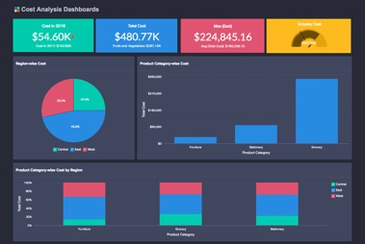
Motivation
Save time by not going home to know what you need or save time when preparing healthy options at home.
Reduce Food Waste
Environment
Convenience
Nutrition
Information
Help People with cook balanced meals and recipes
Give users information of their eating habits so they can make informed decisions

Slide 5


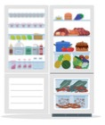



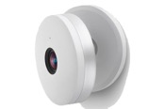


The main idea…
App Dashboard
Computer vision process
Open Fridge
Sends pictures to data base
“Through computer vision, the app is going to recognize and label the items inside the refrigerator through a snapshot taken by the camera
Happy User
Pictures of:
Fridge before opens
User opening the fridge (Verion.2)
Fridge closed
”
Closed Fridge
(with apple)

Slide 6
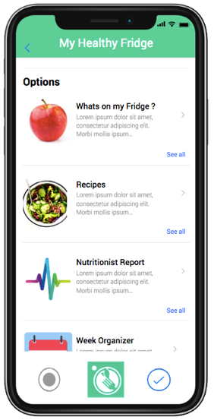
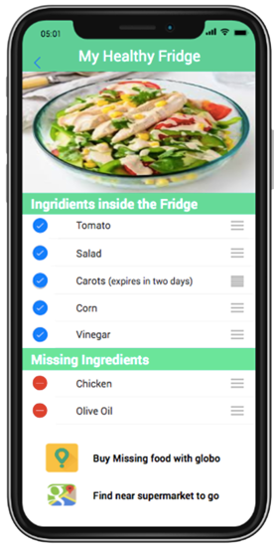
App Prototype – Service and Product
Allowing end users to:
Personalize diets and facilitate grocery shopping via:
Alerts on low stock
Expire ingredients (Version 2.0)
Delivery services
Suggestions of healthy meals that are easily available with the items in the fridge.
Suggestions on meal plans with weekly or monthly detailed

Slide 7
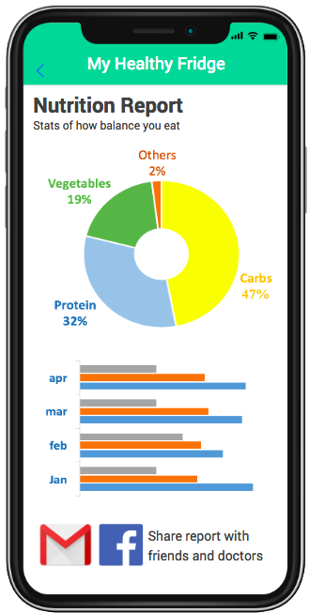


App Prototype – Reporting
“Has the ability to share reports with your fitness group and nutritionist for feedback and motivation by mail”

Slide 8
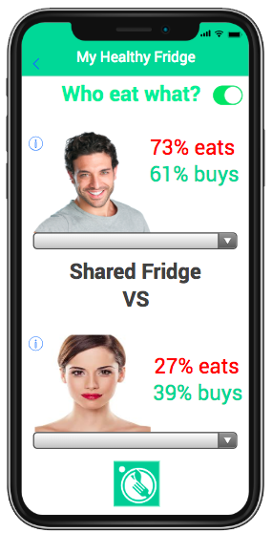
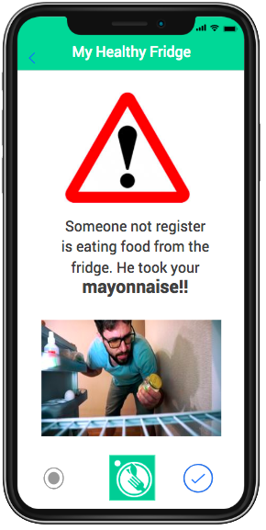
Version 2.0 – Future features
“Stop fighting with your roommate for food”
“Track if someone is eating your food”

Slide 9
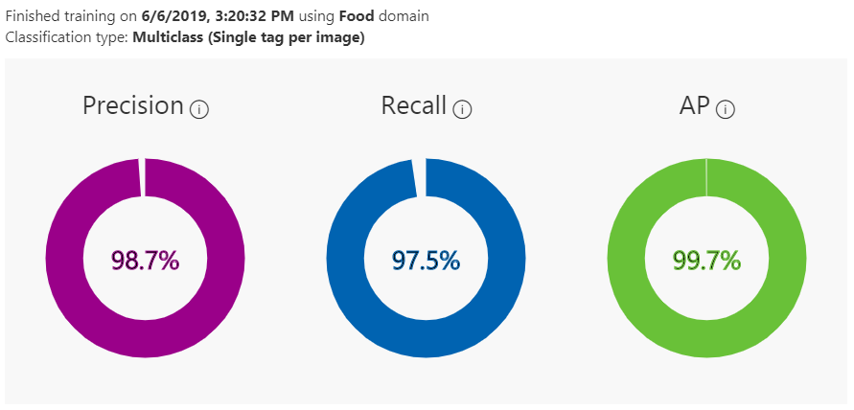
Computer Vision- Training Loop
780 Pictures
15 Different labels

Slide 10



Business Process
In house Operations
Subscription Service
Selling Data as a service
Subscription Service
Software Design
Functionality/Support
Marketing/Sales/Sourcing
First month free with camera included
Basic $10 / Month
Guaranty: If a client doesn’t like the app they can return the camera within the first month.
Premium $18 / Month
Large Retailers:
Retail: Mercadona/Dia
Last Mile Services
( Glovo, Deliveroo)
E-commerce sites: “Amazon”
Independent retailers:
Dr. and Nutritionists looking to get more clients and provide services.
Brands.
Retailers.
Bloggers for Marketing.
Camera fabricator’s: Since you need a camera for pantry, storeroom and refrigerator, they can join the promotion for the first camera for free.

Slide 11
Financial Projections
 |  |  |  |  | Months 2019
 | 1 | 2 | 3 | 4 | 5 | 6 | 7 | 8 | 9 | 10 | 11 | 12
Asumtions
Cameras | 400 | 500 | 600 | 700 | 800 | 900 | 1.000 | 1.100 | 1.200 | 1.300 | 1.400 | 1.500
Users | 100 | 200 | 300 | 400 | 500 | 600 | 700 | 800 | 900 | 1.000 | 1.100 | 1.200
subscription per month | 15 | 15 | 15 | 15 | 15 | 15 | 15 | 15 | 15 | 15 | 15 | 15
Camera cost per item | 80 | 80 | 80 | 80 | 80 | 80 | 80 | 80 | 80 | 80 | 80 | 80
Cashflow Stats
Subscription Sales | - | 1.500 | 3.000 | 4.500 | 6.000 | 7.500 | 9.000 | 10.500 | 12.000 | 13.500 | 15.000 | 16.500
Cost of Subscription | -32000 | -8000 | -8000 | -8000 | -8000 | -8000 | -8000 | -8000 | -8000 | -8000 | -8000 | -8000
Total Expenses | -25000 | -5000 | -5000 | -5000 | -5000 | -5000 | -5000 | -5000 | -5000 | -5000 | -5000 | -5000
Net Income | -57.000 | -11.500 | -10.000 | -8.500 | -7.000 | -5.500 | -4.000 | -2.500 | -1.000 | 500 | 2.000 | 3.500
Total Expenses composition
Marketing | 10.000
App Development | 10.000
Tax & administration | 5.000
“ROI: Return of investments in 9 months”

Slide 12
Future Plans
Selling Data ( after 3-6 months) to:
10k – Drs/Nutrionists, Gyms, Restaurants (more customizable, regional), Last Mile Services
50k – Retailers – Mercadona/Dia
Machine learning to identify eating patterns further provide suggestions/recommendations:
Exit Strategy → Amazon. Sell out to a retailer or last mile service companies.

